Slide 1


CSE 455 SOFTWARE TESTING
Lecture 13
This course is offered to the students of students of BS Software Engineering who are enrolled in 8th semester

Slide 2
COURSE INSTRUCTOR YELLA MEHROZE
yellamehroze@cuilahore.edu.pk

Slide 3

TOPIC: TAXONOMY OF BUGS

Slide 4
Outline
Objectives of Taxonomy of Bugs
Taxonomy of Bugs
Requirements, Features and Functionality Bugs
Structural Bugs
Data Bugs
Coding Bugs
Interface, Integration and System Bugs
Test and Test Design Bugs

Slide 5
Objectives of Taxonomy of Bugs
To understand different categories of bugs
To learn which type of bug should be placed in which category
To learn how to avoid bugs by understanding different types of bugs

Slide 6
1. Requirements, Features and Functionality Bugs
Types of Requirements, Features and Functionality Bugs
Requirements and specification Bugs
Feature Bugs
Feature interaction bugs

Slide 7
1.1Requirements and specification Bugs
Incompleteness:
Example: A professor as a user will log into the system by providing his username, password, and other relevant information
Ambiguous
Example: Students will be able to enrol to undergraduate and post graduate courses
Self-contradictory
Example: (1) While on battery power, if the battery charge falls below 5% remaining, then the system shall display a warning message to switch to AC power.
(2) While on battery power, if the battery charge falls below 10% remaining, then the system shall power down until AC power is available.
Misunderstood or impossible to understand
Example: when waiting for a level to reach target level
Notes:
Incompleteness: In the example what is the other relevant information no one knows.
Ambiguous: The requirement does not specify which students will be able to enrol to undergraduate courses and which will be able to enrol to post graduate courses.
Self-contradictory: These two requirements, as written, are in conflict with each other. If the charge falls below 10%, it turns itself off and prevents itself from turning back on until AC power is applied. However, if the charge falls below 5%, a warning message is displayed. The system cannot display an error message if it is powered down. The conflict must be resolved.
Misunderstood or impossible to understand: The FRS should specify whether the wait should be for the level to drop below the target or rise above the target

Slide 8
1.1Requirements and specification Bugs
Following are some other sources of requirements and specification bugs.
Incomplete information conveyed to the designer about specifications
Features are modified, added or deleted
Analyst’s assumptions not known to designer
Something may miss when specs change
These are expensive because they are introduced early in SDLC and removed at the last

Slide 9
1.2 Feature Bugs
Specification problems create feature bugs
Feature can be wrong, missing or superfluous (unnecessary)
Wrong feature can have deep design implications
Missing feature is easy to detect and correct
Unnecessary enhancements can accumulate bugs, if they increase complexity
When features are eliminated, following consequences arise
S/w becomes more complicated
Consume more resources
Additional bugs are stimulated
Notes:
Wrong feature can have deep design implications: The design of these wrong features can also be wrong because the design will be based on requirements.
When features are eliminated, following consequences arise
When you eliminate any feature, you need to change the business flow of the project, which may increase the complications of the project. Brining this change to the project may utilize more resource of the PC and introduce more bugs.

Slide 10
1.3 Feature Interaction Bugs
Features usually come in groups of related features
The features of each group and the interaction of features within each group are usually tested
Bugs arise due to unpredictable interactions between feature groups or individual features.
The earlier the bugs are removed the better it is; since delay in detection is costly.
Examples: Call forwarding and call waiting
Notes:
Call forwarding and call waiting are separate features. To understand the interaction between feature groups, we can consider the interaction of these two features.
Do you think that Call forwarding and Call waiting features can interact????
The answer is yes. When you have activated both features in your cellular phone. Call forwarding feature will forward the call to the given number. If that number is busy on another call then call waiting feature will also be activated. Both features will interact in this way.
In case of individual feature interaction, you will check that how input is processed in an individual feature. How function are called and data flows in the feature.

Slide 11
2 Structural Bugs
Structural Bugs
Control and Sequence Bugs
Logic Bugs
Processing Bugs
Initialization Bugs
Data-Flow Bugs and Anomalies

Slide 12
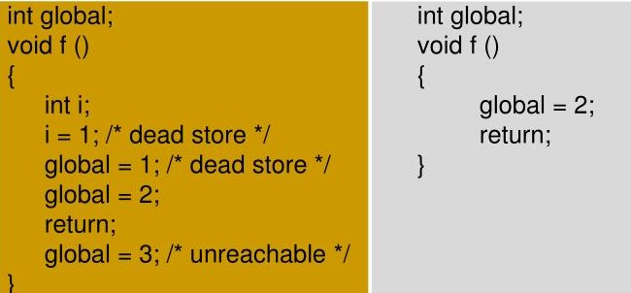
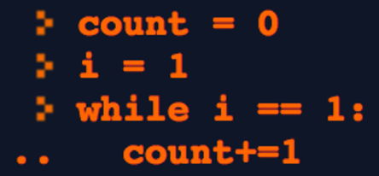
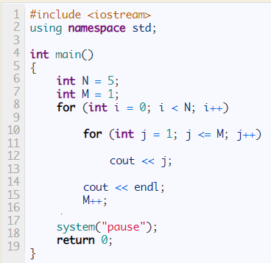
2.1 Control and Sequence Bugs
Control flow specifies a sequence in which instructions (events or paths) are executed
These bugs are most common but easily found during unit testing
Novice programmers tend to have more control flow bugs
Control flow bugs include
Unreachable or dead code
Paths left out
Improper nesting of loops
Loop back or loop termination criteria incorrect
Example: Unreachable or dead code
Example: Loop back or loop termination criteria incorrect
Example: Improper nesting of loops
Notes:
Event. The event is a specific instance of time which makes the start and the end of an activity.
Unreachable Code: Flow is unreachable. Some part of code will never be executed. In the example return statement will terminate the execution of the function. The statement global=3; will never be executed.
Dead Code: Results produced will never be used. In the example the value assigned as global=1 is dead code because the variable is reassigned a value in the next statement without using the previous one.
Paths Left out: For example: based on the test data only if condition is executed and else part is not executed even once.
Improper Nesting of Loop: In the example there should be start and end braces of the outer loop. Otherwise the code will give wrong results.
Loop back or loop termination criteria incorrect: In the example code, there is an infinite loop because the loop termination criteria is wrong.

Slide 13
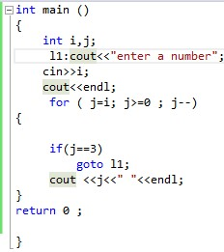
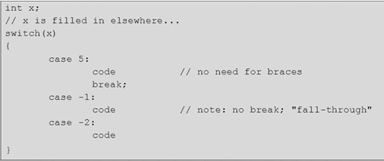
2.1 Control and Sequence Bugs
Missing process steps
Duplicated / un-necessary processing
Use of Go-TOs without justification
Ill conceived switches
Spaghetti code
Example: Ill conceived Switch
Example: Go-To Statement
Notes:
Use of Go-TOs without justification-> The example contains a goto statement that redirects the flow to l1. The problem with using goto statements is that it is easy to develop program logic that is very difficult to understand, even for the original author of the code. It is easy to get caught in an infinite loop if the goto point is above the goto call.
Ill conceived-> means not carefully planned or considered. In the example, there is no default case and break statement is also missing in one of the cases. If we do not use break statement at the end of each case, program will execute all consecutive case statements until it finds the next break statement. If there is no default case, the switch statement is terminated.

Slide 14
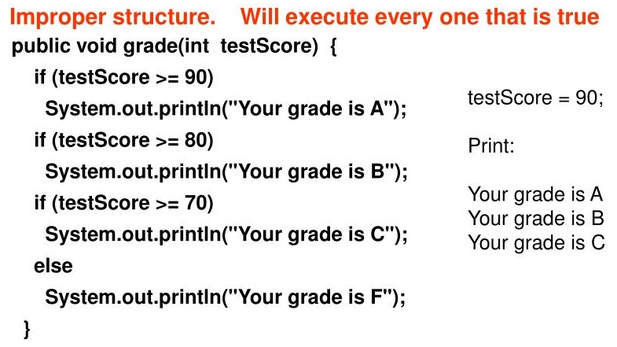
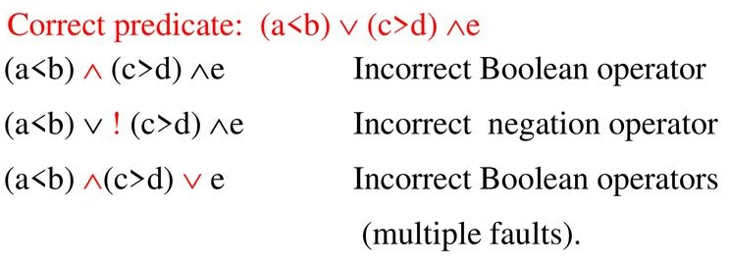
2.2 Logic Bugs
Logic bugs are related to misunderstanding on behavior of case statements and logic operators either singly or in combination
Misunderstanding of the semantics of the order in which a Boolean expression is evaluated for specific compiler
Examples of logic bugs include
Improper lay-out of cases
Improper negation of Boolean expression
Example: Improper negation of Boolean expression
Example: Improper lay-out of cases
Notes:
Improper lay-out of cases: In the example, there are multiple if statements and else statement where there should be if, elseif and else statements. In this case every if statement will be executed that is true.
Improper negation of Boolean expression: In the example you can see the correct Boolean expression, Incorrect Boolean operator single/multiple and incorrect negation operator. Bug can occur due to misunderstanding of Boolean operators.

Slide 15
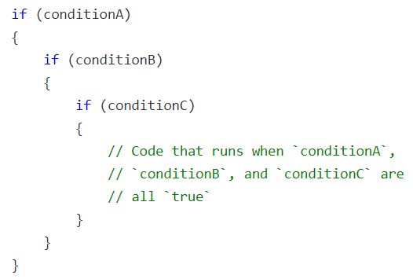
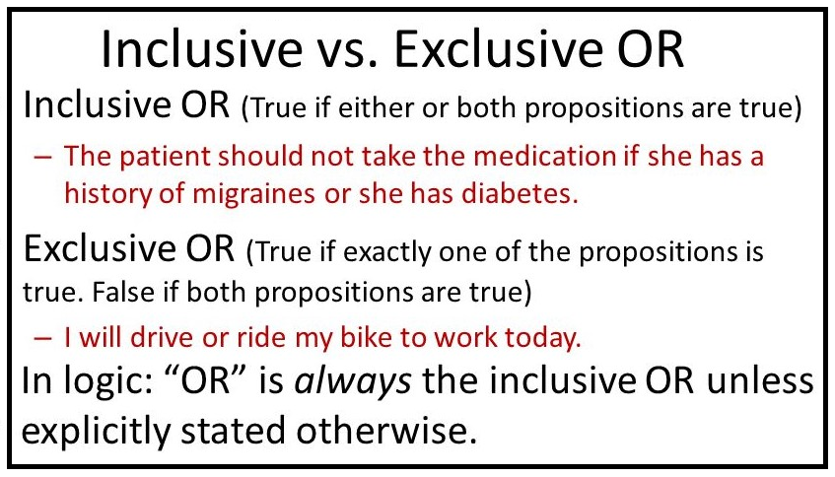
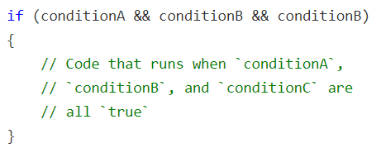
2.2 Logic Bugs
Improper simplification and combination of cases
Non-existent cases
Impossible cases that are not impossible in actual.
Confusing exclusive OR with inclusive OR
Example: Nested If Conditions
Example: Exclusive OR and Inclusive OR
Example: Simplification and Combination of Cases
Notes:
Improper simplification and combination of cases: You can see multiple if conditions in the example. These if conditions are combined with && operator. Bugs can occur if conditions are misunderstood or operators are not used appropriately.
Non Existent case: For example you check in a condition that if the value of month is 13 then print an error message. The 13th month does not exist in actual so this condition will never be executed.
Impossible cases that are not impossible in actual: For example you consider that CGPA greater than 4 does not exist in your country. But the maximum value of CGPA in your country is 5. So the case that you considered as impossible but in actual it is possible.
Confusing exclusive OR with inclusive OR: It is important to understand the difference between inclusive OR and exclusive OR. Please consider the examples.

Slide 16
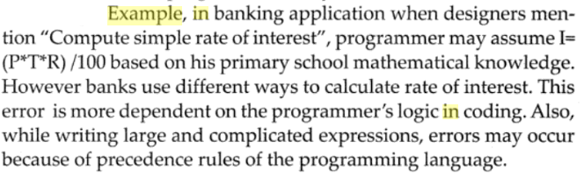
2.3 Processing Bugs
Processing bugs are easy to find bugs during unit testing and have an effect in the program where they occur
These bugs include
Arithmetic bugs
Algebraic bugs
Wrong usage/evaluation of mathematical formula
Notes:
Algebraic Bugs: There are multiple applications of algebra in computer science like in computer graphics and whenever you're manipulating representations of space or geometry. Matrix multiplication problem show up in physics, signal processing, graph theory, and many others. Algebraic bugs can be reported in these areas.

Slide 17
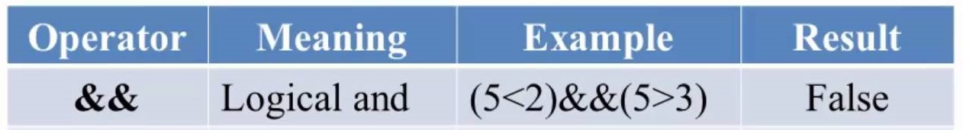
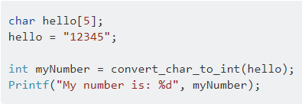
2.3 Processing Bugs
Inappropriate selection of algorithm
Ignoring over-flow
Improper use of logical (NOT, AND, OR, NOR , XOR)and relational operators (greater-than, greater-than-or-equal, less-than, less-than-or-equal )
Incorrect conversion from one data representation to another
Example: Incorrect conversion from char type array to int type array
Notes:
Inappropriate selection of algorithm: You have used Linear Search Algorithm instead of Binary search Algorithm
Ignoring over-flow: This is what we already discussed in terms of buffer overflow
Improper use of and relational operators: Example of improper use of logical and relational operator is in the table. Operator is &&. Here 5<2 can never be true where 5>3 is true. But due to && operator both conditions need to be true.
Incorrect conversion from one data representation to another: The example is given in the picture. Here we have character type array and we store integer value in the array then we try to convert the char array to integer that is wrong.

Slide 18
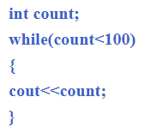
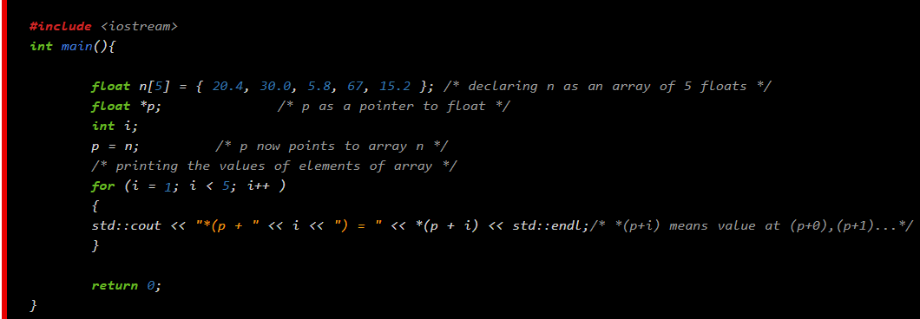
2.4 Initialization Bugs
Initialization errors are common.
Typical bugs include
No initialization of working space registers or data variables before first use
Bug in the initial value in the loop-control parameter
Accepting an initial value without validation check
Initialization with wrong data type
Example: Variable not initialized before use
Example: Bug in the initial value in the loop-control parameter
Notes:
No initialization of working space registers or data variables before first use: In the example the variable count is declared but not initialized and used in the while loop.
Bug in the initial value in the loop-control parameter: In case of array, the loop used to read or write value to an array should start from 0 because the first index of array is 0. Here the loop is starting from 1. The value at 0 index of array will not be printed in this case.

Slide 19
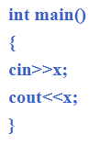

2.5 Data-Flow Bugs and Anomalies
Data flow is a representation of the sequence and possible changes of state of data objects
Where the state of an object is any of creation, usage, modification or destruction.
While data is undergoing transformation, a data flow anomaly occurs when something unexpected or unreasonable with data occurs.
Following are the examples of Data Flow Bugs
Using an uninitialized variable (Already discussed)
Attempting to use the variable without defining it
Referencing a variable with an undefined value
Example: Using the variable without defining it
Example: Referencing a variable with an undefined value
Notes:
Attempting to use the variable without defining it: In the example, the variable x is not declared but used to take input from user.
Referencing a variable with an undefined value: In the example, the variable x is declared but not initialized. A reference variable named foo is created of variable x. Then next is print statement that will print nothing because value is not assigned to x.

Slide 20
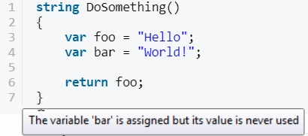
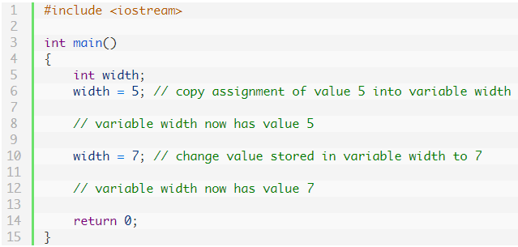
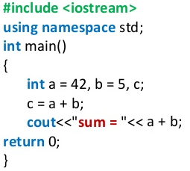
2.5 Data-Flow Bugs and Anomalies
Variables that are never used
Modifying data and not using the result
Double initialization
Example: Variables that are never used
Example: Double initialization
Example: Modifying data and not using the result
Notes:
Variables that are never used: In the example there are two variables foo and bar which are declared and initialized. Variable foo is returned but the value of variable bar is never used.
Modifying data and not using the result: In the example two variable a and b are declared and initialized. Variable c is declared and sum of variables and b is stored in the variable c. In the print statement a+b is being printed and variable c is never used.
Double initialization: Variable width is initialized with value 5 but in the next statement the variable width is assigned a value of 7. So this is double initialization.

Slide 21
3 Data Bugs
Data Bugs
Generic Data Bugs
Dynamic Data vs Static Data
Information, Parameter and Control Bugs
Contents, Structure and Attributes Related Bugs

Slide 22
3.1 Generic Data Bugs
Success of any program depends on its code and also data.
These bugs are much common in code, especially as the code migrates to data
Data is represented in the code as: data types, constants and variables
Data bugs arise while selecting of appropriate types, object specs., their formats, no. of such data objects and their initial values
In addition, data representation in the form of database and normalization also plays a very critical role.

Slide 23
3.2 Dynamic vs. Static Data Bugs
Dynamic Data Bugs
Data is transitory.
The data are created during the transaction and stored in the shared memory.
At the end of transaction, dynamic data is not required and shared memory is released.
Short lifetime, typically the processing time of one transaction
Dynamic data is being used to produce results
Difficult to catch bugs
Performing root cause analysis is not easy
A common error is the programmer tries to free the already freed resources
A memory leak situation. Such a situation can cause ever increasing usage of memory and resulting in unexceptional halt of program.
Static Data Bugs
Static data rarely changes
Long life time.
Appear in source code as corded data or data stored in the database
Compile time processing will solve the bugs caused by static data.
For example a number, a string of characters, or a bit pattern used to store company name and address

Slide 24
3.3 Information, Parameter and Control Bugs
Roles of Static or Dynamic Data
Parameter
Control
Information
Notes:
Static or dynamic data can serve in any of the three forms.

Slide 25
3.3 Information, Parameter and Control Bugs
Parameter: Parameters are used in the form of input and output data
Passed to call a function as input data
Care should be taken to ensure exact number and order of data for inputs and outputs
Control: Control data is stored to support the business rules for the maintenance of the information.
Example- In a Payroll application, it would be the data stored on the government tax rates for each pay scale and the date at which the tax rate became effective.
Information: Information type of data is usually dynamic
Local to a single transaction or task
Frequently changes in response to changes in processing, external functional processes and/or business rules in the form of control data
Information data is produced by executing the code by using parameter data and processing it using control data.

Slide 26
3.4 Content, Structure and Attributes related Bugs
Data Specification Addresses
Contents
Structure
Attributes
Notes:
Data specification addresses the following three parts

Slide 27
3.4 Content, Structure and Attributes related Bugs
Contents: These are actual bit patterns, character strings or numbers.
The data is interpreted by a hardware or software processor before putting it into data structure.
Bugs result in the corruption or misinterpretation of the content while doing encryption or decryption.
Structure: The structure of data is about organization of data. It specifies type, size and number of items that can be stored in the structure.
It is the memory locations used to store the content.
Structure bugs may be due to
Wrong declaration
When same contents are interpreted by multiple structures differently
Example: A bug can be a two dimensional array treated elsewhere as N one dimensional arrays.

Slide 28
3.4 Content, Structure and Attributes related Bugs
Attributes: The semantics associated with the contents of a data object
Example: An integer, string, alphanumeric etc.
Attributes bugs are due to misinterpretation of data type, probably at an interface

Slide 29
4 Coding Bugs
Coding Bugs
Coding Errors
Syntax Errors
Documentation Bugs

Slide 30
4 Coding Bugs
Coding errors create other kinds of bugs
Typographical
Misunderstanding of operators or statements
Syntax errors are removed when compiler checks syntax
Syntax errors can be:
Undeclared data (Already Discussed)
Dangling code
Initialization problems (Already Discussed)
Documentation Bugs
Common documentation bugs include:
Spelling error
Poor writings
Erroneous comments could lead to incorrect maintenance
Testing techniques cannot eliminate documentation bugs
Notes:
Dangling pointers arise during object destruction, when an object that has an incoming reference is deleted or deallocated, without modifying the value of the pointer, so that the pointer still points to the memory location of the deallocated memory.

Slide 31
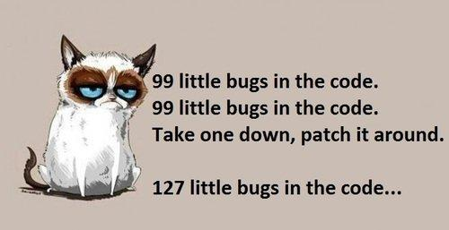
4 Coding Bugs
Notes:
When you miss a semicolon in the code and compile the code, the compiler will show bugs in all next lines of the code. When you place the semicolon and compile the code a number of other bugs appear. This might have happened to you when you were a beginner.

Slide 32
5 Interface, Integration and System Bugs
Interface, Integration and System bugs
External Interfaces
Internal Interfaces
Hardware Architecture Bugs
Operating System Bugs
Software architecture bugs
Control and Sequence Bugs
Resource management bugs
Integration Bugs
System Bugs
Notes:
There are 9 types of Interface, Integration and System bugs.

Slide 33
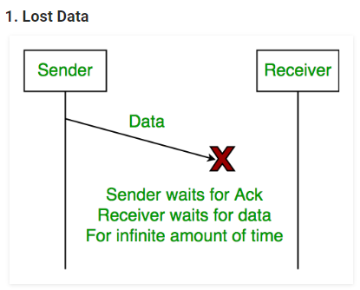
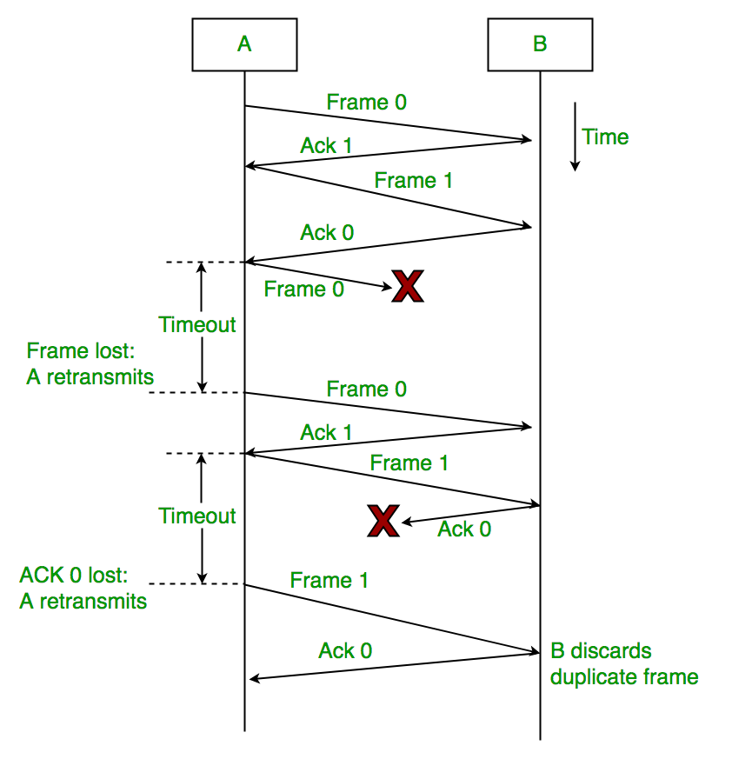
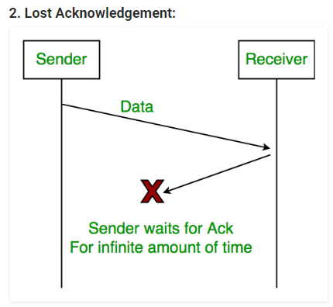
5.1 External Interface
Means used to communicate with the world include:
Drivers
Sensors
Input terminals
Communication lines
These bugs can be due to:
A protocol that may be wrong or incorrectly implemented
Invalid timing/ Synchronization related bugs
Sequence assumptions related to external signals
Input and Output data inappropriate formats
Unavailability of servers
Example: Sequence assumptions related to external signals
Example: Invalid timing/ Synchronization related bugs
Notes:
Invalid timing/ Synchronization related bugs: In the picture at the top right side, sender sends data but that is lost. Sender waits for ACK and receiver waits for data for infinite amount of time. In the picture at the bottom right side, sender sends data, receiver receives it and sends ACK but that ACK is lost. Sender waits for ACK for infinite amount of time.
Sequence assumptions related to external signals: In the picture at the left side, when ACK0 is sent by Receiver B, it means receiver is ready to receive Frame0. Frame0 is sent by Sender A but it is lost. When there is time out, and no ACK is received for next frame, the Frame0 is sent again.

Slide 34
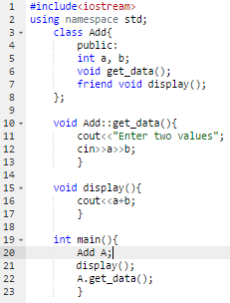
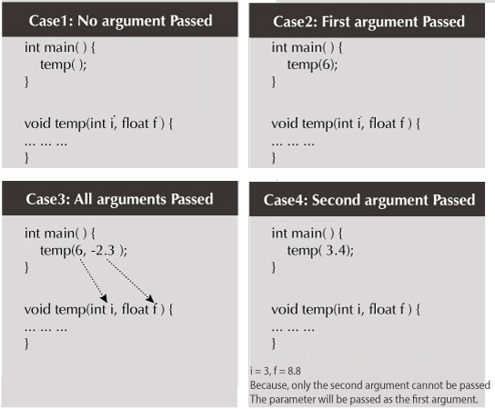
5.2 Internal Interface
Internal interfaces can be negotiated but it must adapt to external interface
Bugs include:
Protocol design bugs
Input output bugs
Wrong calling sequence
Call-parameter bugs
Example: Wrong calling sequence
Example: Call-parameter bugs
Notes:
Wrong calling sequence: Have a look at the picture at the right side. In the main function, the function get_data should be called before display function.
Call-parameter bugs: Consider the picture on the left side. There are four cases and the function temp is called in each case from the main function. In case1 no argument is passed while calling temp function. In case 2 only first argument is passed while calling temp function. In case 4 only second argument is passed while calling temp function. Al these cases are wrong. However, in case 3 both arguments are passed and this is the correct way to call the function.

Slide 35
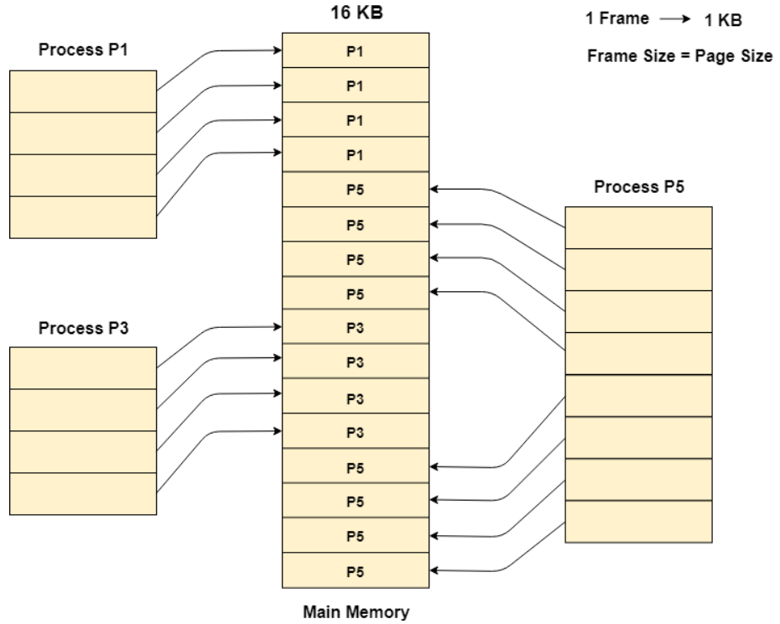
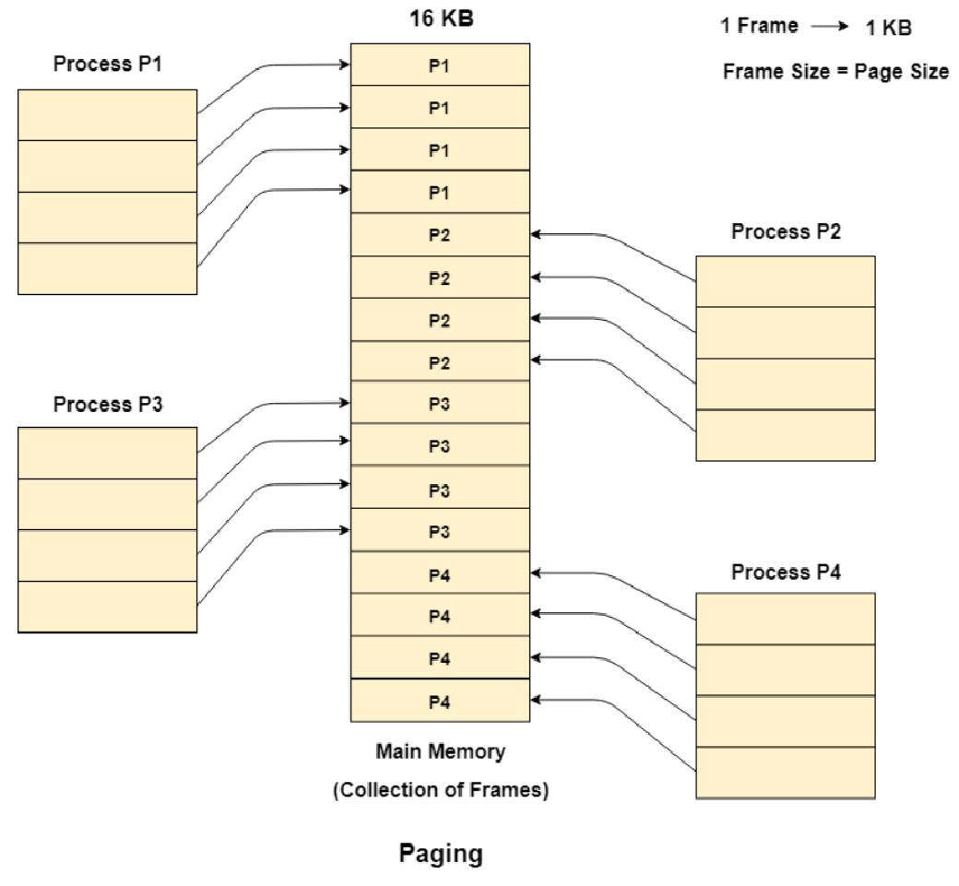
5.3 Hardware Architecture
A software programmer may not see the hardware layer/architecture
Software bugs originating from hardware architecture are due to misunderstanding of how hardware works
Hardware bugs include:
Paging mechanism ignored or misunderstood
Example: Paging mechanism ignored or misunderstood
Notes:
Paging: In Operating Systems, Paging is a storage mechanism used to retrieve processes from the secondary storage into the main memory in the form of pages. Each process is divided in the form of pages whereas main memory is divided in the form of frames. One page of the process is to be stored in one of the frames of the memory. The pages can be stored at the different locations of the memory but the priority is always to find the contiguous frames.
Consider the example in the picture at the right side. The main memory size is16 Kb and Frame size is 1 KB therefore the main memory will be divided into the collection of 16 frames of 1 KB each. There are 4 processes in the system that is P1, P2, P3 and P4 of 4 KB each. Each process is divided into pages of 1 KB each so that one page can be stored in one frame.
Initially, all the frames are empty therefore pages of the processes will get stored in the contiguous way.
When P2 and P4 are moved to waiting state after some time then 8 frames become empty and therefore other pages can be loaded in that empty place. The process P5 of size 8 KB (8 pages) is waiting inside the ready queue.
Given the fact that, we have 8 non contiguous frames available in the memory and paging provides the flexibility of storing the process at the different places. Therefore, we can load the pages of process P5 in the place of P2 and P4. You can see this in the picture on the left side.

Slide 36
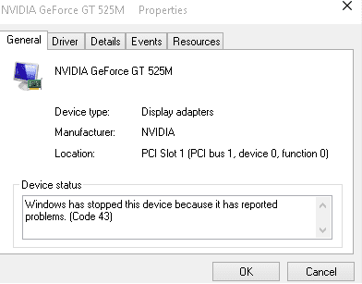
5.3 Hardware Architecture
Example: When functionalities of a printer are to be performed, we need to send instructions of a particular job from desktops or laptops. Similarly when functionalities of a mobile device are to be tested, then calls shall be initiated from the handset. It will result in the following types of bugs
I/O device instruction or operation error
I/O device address error
No compatibility among hardware devices
Misunderstood device status code
Data format wrong for device
Device protocol error
Expecting the device to respond too quickly
Waiting too long for response
Assuming that the device is initialized
Ignoring hardware fault or error conditions
Example: Misunderstood device status code
Notes:
Assuming that the device is initialized: Assuming that BIOS has checked the hardware for all its input and output components. When you start your PC, it is checked for all its basic components like RAM, ROM, Graphics Card, Hard Drive as well as for Operating system files.
Misunderstood device status code: In the picture you can see the device status description section in which a code is given that is Code43. One may misunderstand the purpose of this status code.

Slide 37
5.4 Operating System (OS)
OS bugs are a combination of hardware architecture and interface bugs
Caused by:
Misunderstanding of hardware architecture & interface by the OS
Not handling of all hardware issues by the OS
Bugs in O.S. itself and some corrections may leave quirks
Missing device drivers because of which interface related bugs may crop up
Notes:
Not handling of all hardware issues by the OS: Usually when a hardware issue is encountered, the operating system shows an error message along with error code. This is due to the proper identification of hardware issue by operating system. It might be happened that some hardware issue is ignored/ not identified by operating system.

Slide 38
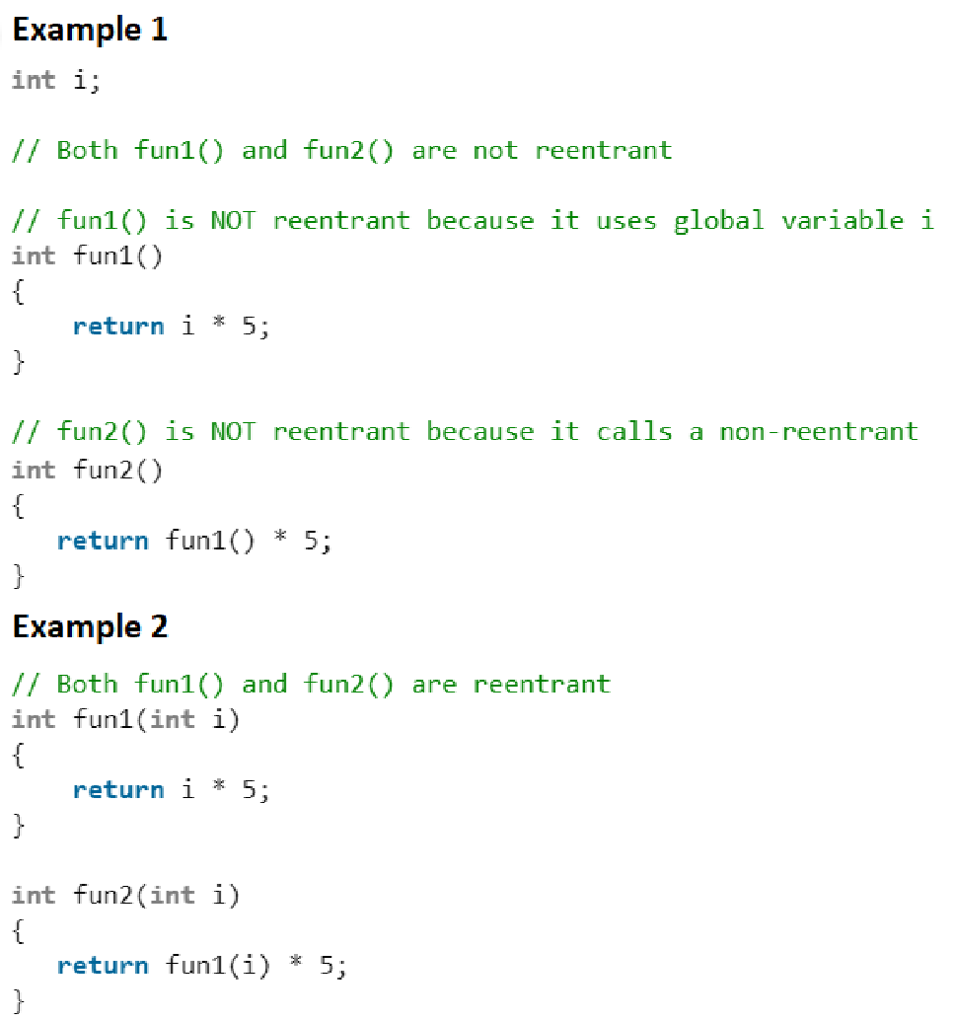
5.5 Software Architecture
Non-functional requirements may include reliability, efficiency, usability, portability and maintainability.
The bugs can be like
Failure to support required number of users and concurrent users
Slower response time during peak performance
Failure to support other languages
These bugs are due to
Assumption that there are no interrupts
Assumption that code is re-entrant or not re-entrant
Bypassing data interlocks, Or, Failure to open an interlock
Assumption that a called routine is memory resident or not
Assumption that the registers and the memory are initialized
Local setting of global parameters & Global setting of local parameters
Example: Assumption that code is re-entrant or not re-entrant
Notes:
Interrupt: An interrupt is a signal from a device attached to a computer or from a program within the computer that requires the operating system to stop and figure out what to do next.
Re-entrant: A function is re-entrant if it can be invoked while already in the process of execution.
One function is said to be a re-entrant function if there is a provision to interrupt that function in the course of execution. This type of functions is used in different cases like, recursions, hardware interrupt handling.
Example of Re-entrant Functions: In the example code in the picture, fun2 is a re-entrant function. If an interrupt that pauses its execution and shifts the control to fun1. After fun1 completes, the control is again transferred to fun2 and it re-enters the execution phase.
Data interlocking- If a deadlock occurs because the two processes access the same resources but in a different order, then it is enough to change the order of blocking resources. In principle, if a certain set of resources are blocked in different operations, the same resource should always be blocked first, if possible. This advice applies not only to relational databases, but generally to any systems in which interlocks occur.
Routines: Routines are synonymous terms for any sequence of code that is intended to be called and used repeatedly during the execution of a program. Memory Resident: means requires memory for data storage.
Register: A register stores the memory address from which data will be fetched from the CPU, or the address to which data will be sent and stored.

Slide 39
5.6 Control and Sequence Bugs
These include:
Failure of execution of events in a required sequence
No activation of any event at the required time
Assumption that events occur in a specified sequence
Process initiation even when prerequisites are not fulfilled
Waiting for an impossible combination of prerequisites
No activation even when prerequisites are satisfied
Specifying wrong priority, Program state or processing level
Missing, wrong, redundant, or superfluous process steps
In these systems most of the bugs are related to synchronization
These bugs are hard to find

Slide 40
5.7 Resource Management Problems
Resources include:
Internal: Memory buffers, queue blocks, task control blocks, registers
External: discs
These bugs are due to
Unavailability of required resources
Wrong resource used
Resource already in use, or deadlock
Race conditions in getting resources
Resource not returned to the right pool, Failure to return a resource. Resource use forbidden to the caller.
Unavailability of required server
Unavailability of required bandwidth
Link failure
Denied access to server
Notes:
Task Control Block: Task Control Block is a data structure used by kernels to maintain information about a task.
Wrong resource used: When several resources have similar structure or different kinds of resources in the same pool, there are chances that wrong resource may be selected.

Slide 41
5.8 Integration Bugs
Are detected late in the SDLC and cause changes in several components and hence are very costly
These bugs are due to:
Inconsistencies or incompatibilities between components.
Error in a method used to directly or indirectly transfer data between components.
Some communication methods are:
Data structures
Call sequences
Registers
Network Communication links
Protocols etc
Notes:
Data Structure: is a collection of data values, the relationships among them, and the functions or operations that can be applied to the data.
Register: A processor register (CPU register) is a data holding place that is part of the computer processor. A register may hold an instruction, a storage address, or any kind of data.
Network Communication links: Means which communication link you will use either LAN, WAN, MAN or Wireless. Which devices like router, switch etc. will be used during transmission of packets.

Slide 42
5.9 System Bugs
System bugs cover all types of bugs including both functional and non functional.
Infrequent, but are costly
Bugs result from the totality of interactions among many components such as:
Programs
Data
Hardware
Operating System

Slide 43
5.9 System Bugs
Some of the system bugs include:
Missing functionality
Wrong functionality
Extra functionality
Failure to meet required performance
Failure to handle large volumes of information
Failure to handle peak volumes of information
Inappropriate documentation
System that is not stable
These bugs are directly related to customer and user satisfaction

Slide 44
6. Test and Test Design Bugs
Test and Test Design Bugs
Testing Method
Test Criteria
Testing

Slide 45
6.1 Testing Method
Testing method bugs are due to:
Testers have no immunity to bugs
Testing requires code to execute, and consequently they can have bugs
Test bugs are not software bugs
Test bugs may be due to faulty test specification

Slide 46
6.2 Test Criteria
Test criteria bugs can be due to the following reasons.
Criteria by which software behavior is judged is incorrect or impossible
If the criteria is quantitative such as in case of performance, throughput or processing delay, the performance can be measured
The more complicated the criteria, the more likely they are to have bugs

Slide 47
6.3 Testing/ Remedies
Test Debugging:
It is all about finding any issues related to test cases, test coverage and trying to address these issues in order to increase efficiency.
Test Quality Assurance:
To monitor and control skills and competency of testers, capability of test related process and quality of test design.
Text Execution Automation:
Test execution bugs are eliminated by test execution automation tools & not using manual testing. Tests designed by tester can be recorded in these tools and same can be played back to complete testing in a shorter period of time.
Test Design Automation:
Test design is automated like automation of software development. For a given productivity rate, It reduces bug count. These tools are of use in automating test design at code level and also at system level.

Slide 48
References
Chapter 2
Software Testing Techniques 2nd Edition by Boris Beizer

